Slide 1


Data Structure
Dr. Shahjad
Faculty
School of Engineering & Technology
K.R. Mangalam University
Unit 4 : Sorting and Searching
Dr. Shahjad

Slide 2


Binary Search
Binary Search
How to search an Element
Example of Binary Search
Algorithm of Binary Search and Its
Applications
Complexity Analysis of the Binary Search
Brainstorming Session

Slide 3

Objective Session
In this module, we will:
Try to speed up our search by preprocessing the array by sorting it
Understand the prerequisites of the Binary Search algorithm
Understand the working of the Binary Search algorithm
Practice the algorithm
Test your conceptual understanding with a short quiz

Slide 4
RECAP
In Linear search, we simply traverse the list completely and
match each element of the list with the item whose location is to
be found.
If the match is found, then the location of the item is returned; otherwise, the algorithm returns NULL.

Slide 5
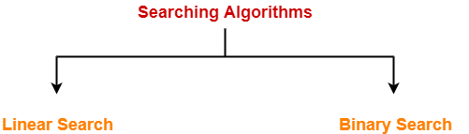
Searching
Searching is a process of finding a particular record, which can be a single element or a small chunk, within a huge amount of data.

Slide 6

Binary Search
What is Binary Search?
Search a sorted array by repeatedly dividing the search interval in half.
Begin with an interval covering the whole array.
If the value of the search key is less than the item in the middle of the interval, narrow the interval to the lower half.

Slide 7
Important Observations
Let's take note of a few important observations :
Let's take note of a few important observations:
It is crucial for the element array to be sorted to be able to search for a query element.
We jump intervals and prune out the array intervals that we are sure will not contain the query element
If the element is not present in the array we are guaranteed that the
algorithm returns failure.

Slide 8
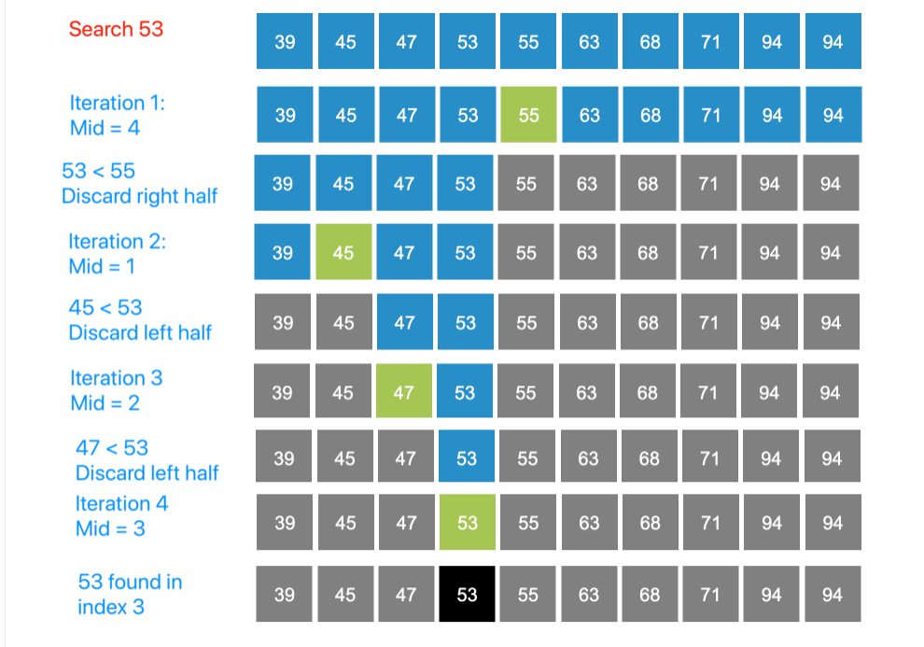
Step by Step Process for Searching an Element

Slide 9
Algorithm
Binary_Search(a, lower_bound, upper_bound, val) // 'a' is the given array, 'lower_bound' is the index of the first array element, 'upper_bound' is the index of the last array element, 'val' is the value to search
Step 1: set beg = lower_bound, end = upper_bound, pos = - 1 Step 2: repeat steps 3 and 4 while beg <=end
Step 3: set mid = (beg + end)/2 Step 4: if a[mid] = val
set pos = mid print pos
go to step 6

Slide 10
Algorithm
else if a[mid] > val set end = mid - 1 else
set beg = mid + 1 [end of if]
[end of loop]
Step 5: if pos = -1
print "value is not present in the array" [end of if]
Step 6: exit

Slide 11
Algorithm
STEP 1 : Start with the middle element.
If the target value is equal to the middle element of the array, then return the index of the middle element.
If not, then compare the middle element with the target value,
If the target value is greater than the number in the middle index, then pick the elements to the right of the middle index, and start with Step 1.
If the target value is less than the number in the middle index, then pick the elements to the left of the middle index, and start with Step 1.
STEP 2 : When a match is found, return the index of the element matched. STEP 3 : If no match is found, then return failure

Slide 12
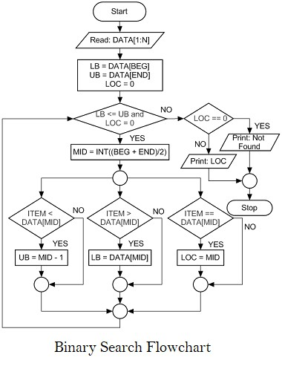
Binary Search
https://akacademy.co.in/2021/06/c-program-algorithm-for-binary-search.html

Slide 13

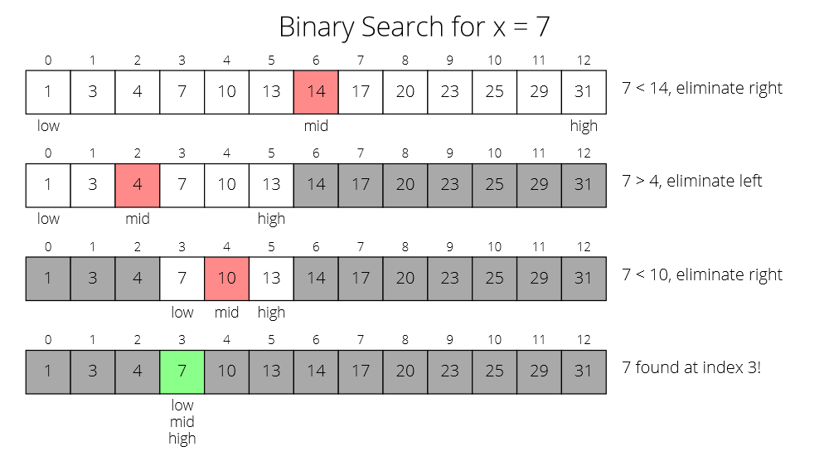
Example
https://ottobotcode.com/binarySearch/index.html

Slide 14
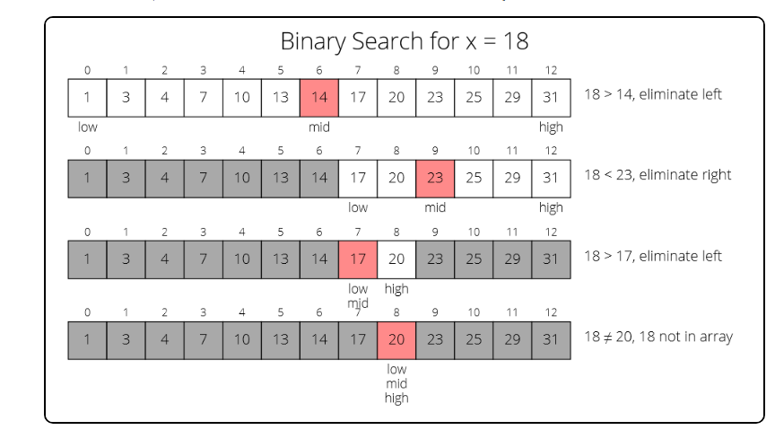
Example
https://ottobotcode.com/binarySearch/index.html

Slide 15

Binary Search complexity
Case | Time Complexity
Best Case | O(1)
Average Case | O(logn)
Worst Case | O(logn)
The space complexity of linear search is O(1).

Slide 16
Applications of Binary Search
Binary search can be used as a building block for more complex algorithms used in machine learning, such as algorithms for training neural networks or finding the optimal hyper parameters for a model.
It can be used for searching in computer graphics such as algorithms for ray tracing or texture mapping.
It can be used for searching a database.

Slide 17
Advantages of Binary Search
Binary search is faster than linear search, especially for large arrays.
More efficient than other searching algorithms with a similar time complexity, such as interpolation search or exponential search.
Binary search is well-suited for searching large datasets that are stored in
external memory, such as on a hard drive or in the cloud.

Slide 18
Disadvantages of Binary Search
The array should be sorted.
Binary search requires that the data structure being searched be stored in contiguous memory locations.
Binary search requires that the elements of the array be comparable, meaning that they must be able to be ordered.

Slide 19
Code
Iteration Method
do until the pointers low and high meet each other. mid = (low + high)/2
if (x == arr[mid]) return mid
else if (x > arr[mid]) // x is on the right side low = mid + 1
else // x is on the left side
high = mid - 1

Slide 20
Code
Recursive Method
binarySearch(arr, x, low, high) if low > high
return False else
mid = (low + high) / 2 if x == arr[mid]
return mid
else if x > arr[mid] // x is on the right side return binarySearch(arr, x, mid + 1, high)
else // x is on the left side return binarySearch(arr, x, low, mid - 1)

Slide 21
Parameters | Linear Search | Binary Search
Definition | Linear Search sequentially checks each element in the list until it finds a match or exhausts the list. | Binary Search continuously divides the sorted list, comparing the middle element with the target value.
Time Complexity | The time complexity is O(n), where n is the number of elements in the list. | The time complexity is O(log n), making it faster for larger datasets.
Efficiency | Less efficient, especially for large datasets. | More efficient, especially for large datasets.
Data Requirement | Does not require the list to be sorted. | Requires the list to be sorted.
Implementation | Easier to implement. | Requires a more complex implementation.
Search Space | Examines each element sequentially. | Eliminates half of the search space with each comparison.
Use Case | Suitable for small and unsorted datasets. | Ideal for large and sorted datasets.

Slide 22
Test Your Knowledge
What is the prerequisite to perform Binary Search?
a: The values in the array have a maximum bound value they can take b: Array must be sorted either in ascending or descending order
c: Array must be broken into sub-arrays d: None of the above
Binary Search is an example of algorithm.
a: Greedy
b: Dynamic Programming c: Backtracking
d: None of the above

Slide 23
Let us assume an array [1,23,145,178,1203]. How many iterations are needed to find 23? [Assuming we are considering floor of values for floating point values, and index starting from 1]
a: 3
b: 4
c: 2
d: 5
Let us assume an array [11, 33, 145, 1294, 1356, 1450, 3300, 4500, 6000, 8000,
9000]. Let us search for 4500 using binary search. What would be the mid values at the second and third iteration respectively? [Assuming we are considering floor of values for floating point values, and index starting from 1]
a: 1450 and 6000
b: 6000 and 3300
c: 6000 and 4500
d: 1450 and 4500

Slide 24
What is the space complexity of binary search implemented using recursion?
a: O(1)
b: O(N)
c: O(N log N) d: O(log N)
What is the recurrence relation for the binary search?
a: T(n) = T(n/2 + 1) + O(1)
b: T(n) = T((n+1)/2) + O(1)
c: T(n) = T(n/2) + O(1)
d: T(n) = 2*T(n/2) + O(1)

Slide 25
In a linked list, which algorithm can be used to search for an element?
a: Binary Search b: Linear Search
c: Both Linear and Binary Search d: None of the above
Let us consider a sorted array of length N. What would be the best time complexity of the algorithm to find a pair of numbers such that absolute difference between them is equal to p? (i.e (x,y) where |x-y| = p)
a: O(N)
b: O(N^2)
c: O(log N)
d: O(log(log N))

Slide 26
Binary search is better than linear search for a static sorted array.
a: True b: False
In an array, what would be the time complexity to find the closest upper bound of a given number?
a: O(log N) b: O(N log N) c: O(1)
d: O(N)

Slide 27
Quiz Answers
Questions | Answers
1 | b
2 | d
3 | a
4 | b
5 | d
6 | c
7 | b
8 | a
9 | a
10 | d

Slide 28
Exercises
Given a sorted array {2, 4, 6, 8, 10, 12, 14, 16, 18, 20}, perform a binary search to find the index of the element 12.
What is the maximum number of comparisons required in a binary search on an array of size 1024?
If a binary search algorithm takes 4 comparisons to find the desired element in an array of size 16, what is the maximum number of comparisons it would take for an array of size 32?
Suppose you have a sorted array of 100 elements. If a binary search is conducted and the element is not found, how many comparisons were made in the worst-case scenario?
Given a sorted array {1, 3, 5, 7, 9, 11, 13, 15, 17, 19}, perform a binary search to find the index of the element 14.

Slide 29
Exercises
In a binary search, if the target element is not present in the array, what is the maximum number of iterations required to determine its absence in an array of size n?
Suppose you have a sorted array of size 256. If a binary search is conducted and the target element is found after 5 comparisons, what is the maximum number of elements that could have been inspected before finding the target element?
Consider an array of size 32 in which a binary search is performed. If the target element is found after 3 comparisons, what is the maximum number of elements that could have been inspected before finding the target element?
In a binary search, if the target element is present in the array, what is the maximum number of iterations required to find it in an array of size n?
Given a sorted array {1, 2, 3, 4, 5, 6, 7, 8, 9, 10}, perform a binary search to find the index of the element 8. Additionally, determine the number of iterations required to find the element.

Slide 30


REVIEW
In Binary search, we adopt the following strategy:
Sort the array elements.
Search a sorted array by repeatedly dividing the search interval in half.
Begin with an interval covering the whole array.
If the value of the search key is less than the item in the middle of
the interval, narrow the interval to the lower half.
Otherwise narrow it to the upper half. Repeatedly check until the value is found or the interval is empty.

Slide 31

THANK YOU

